Slide 1
Map Reduce Programming
K-Means & Mahout
Speaker: Paul
Professor: Hsiao-Ping Tsai
Date:2016/06/15

Slide 2
Outline
K-Means
Mahout Installation and Configuration
Test the installation

Slide 3
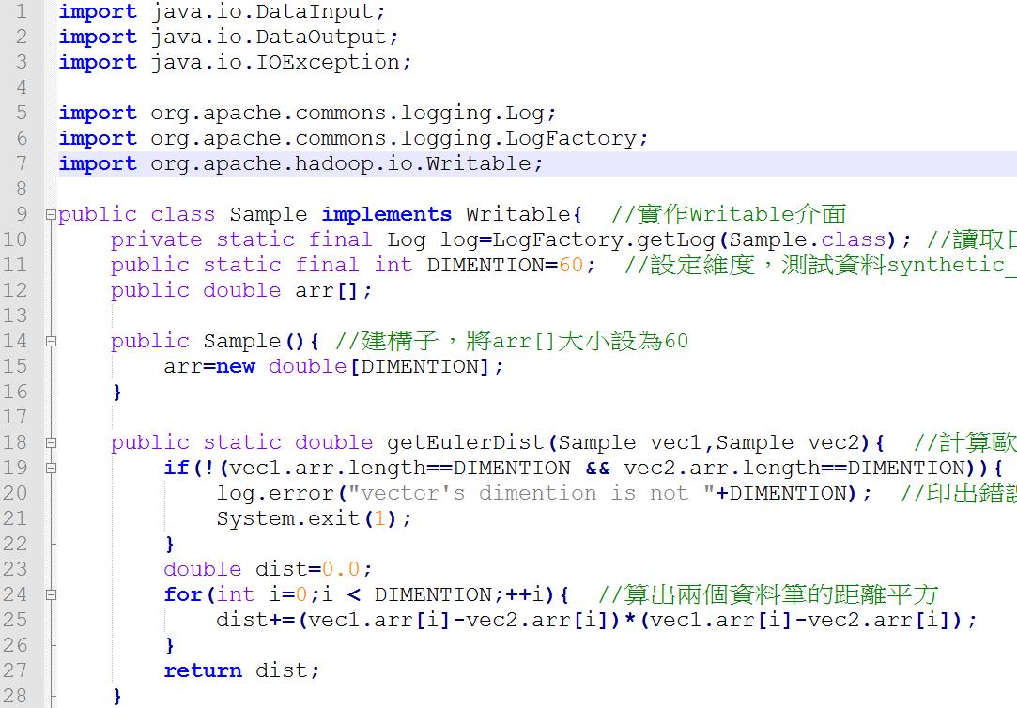
K-Means Sample (1/12)
Notes:
Sample實作Writable介面，必須實作readFields和write方法
三個全域變數log(讀取日誌檔)，DIMENTION(設定維度，測試資料synthetic_control.data中每筆資料點有60個屬性)，arr[](存放資料每個屬性值)
Sample建構子，將arr[]大小設為60
方法getEulerDist，引數為兩個Sample物件，回傳值為一個double，計算兩筆資料間的歐幾里德距離

Slide 4
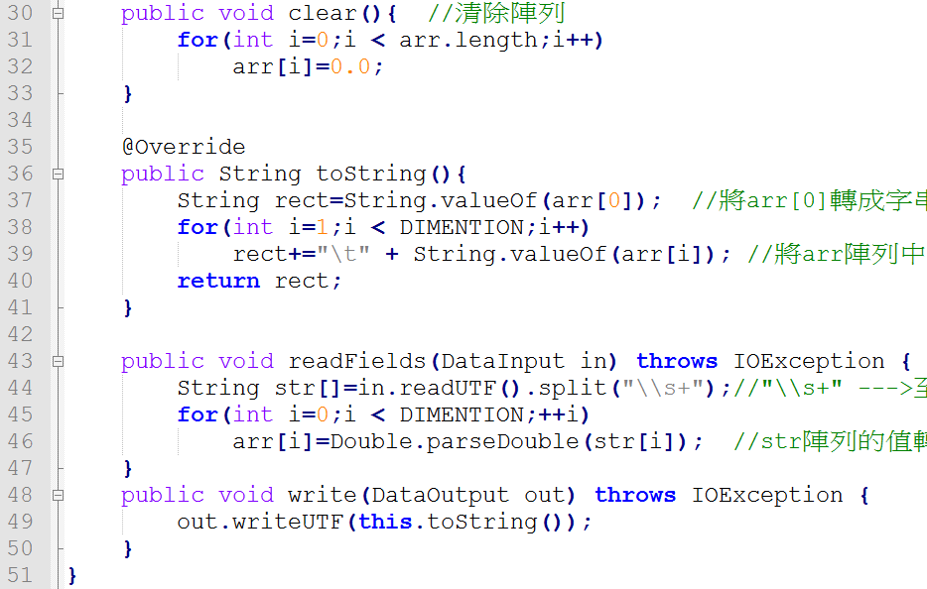
K-Means Sample (2/12)
Notes:
方法clear，將arr[]裡面每個都設為0.0
方法toString( )，先將arr[0]加到rect，之後再將arr[]其它的值轉字串加入rect
方法readFields，先將資料讀一行進來然後切割放到str[]。之後將str[]的值轉成doubl放到arr[]
方法write，寫檔

Slide 5
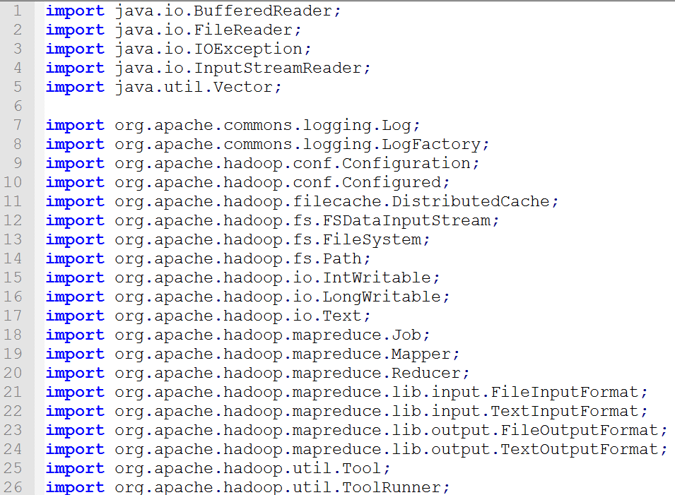
K-Means KMeans (3/12)

Slide 6
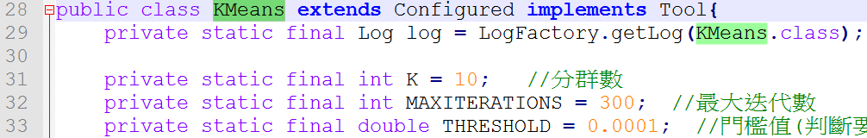
K-Means KMeans (4/12)
Notes:
Kmeans繼承Configured實作Tool，必須要實作run方法(p12)
四個全域變數log(讀取日誌檔)，K(設定分群數)，MAXITERATIONS(最大迭代數)，THRESHOLD(門檻值，判斷是否繼續迭代的條件)

Slide 7
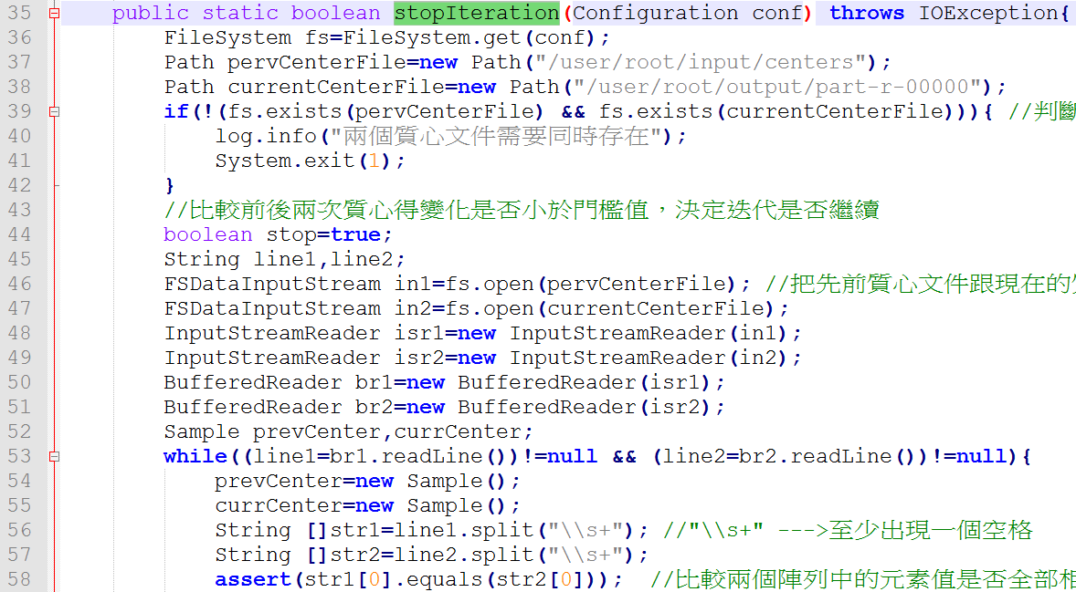
K-Means KMeans-stopIteration (5/12)
pervCenterFile
1 (…..
2 (…..
…
currentCenterFile
1 (…..
2 (…..
…
Notes:
方法stopIteration

Slide 8
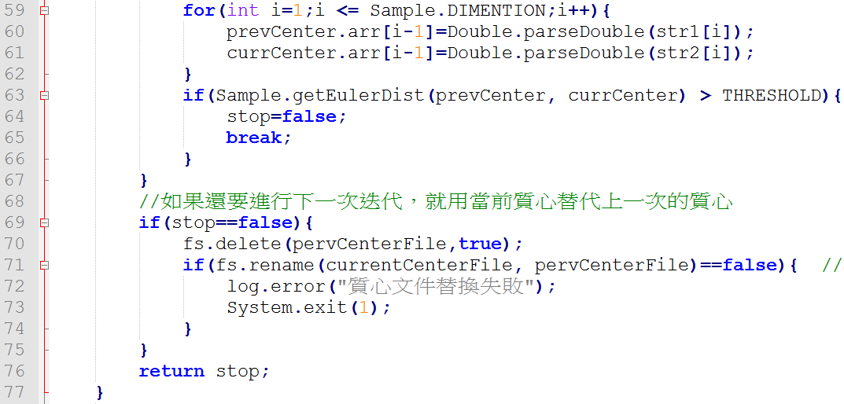
K-Means KMeans-stopIteration (6/12)
pervCenter
x (…..
getEulerDist
currentCenter
x (…..
/user/root/output/part-r-00000
/user/root/input/centers

Slide 9
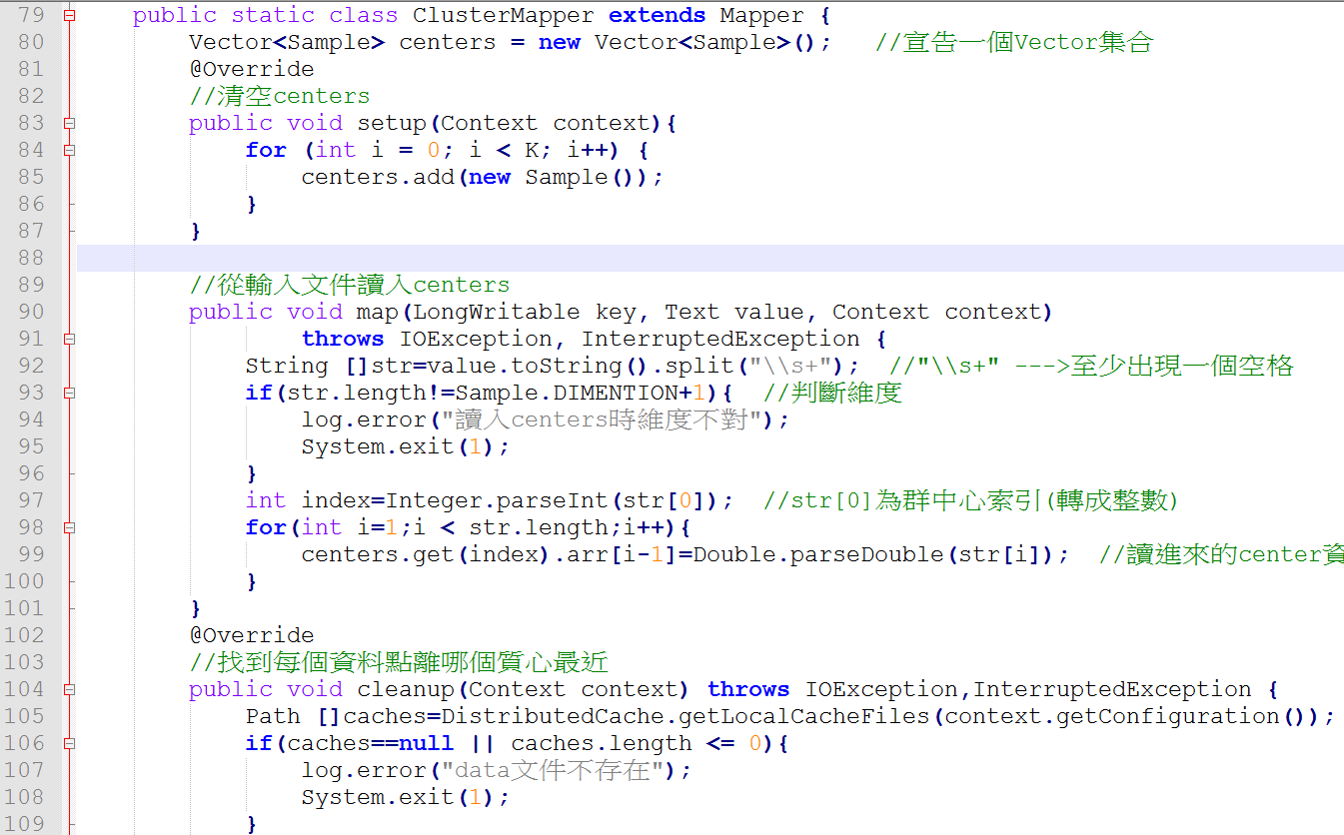
K-Means Kmeans- ClusterMapper (7/12)
/user/root/input/centers
1 (….
2 (….
…
arr[] = {0.0,2.3,3.5,….}
str[] = {x,0.0,2.3,3.5,…..}
/user/root/input/synthetic_control.data

Slide 10
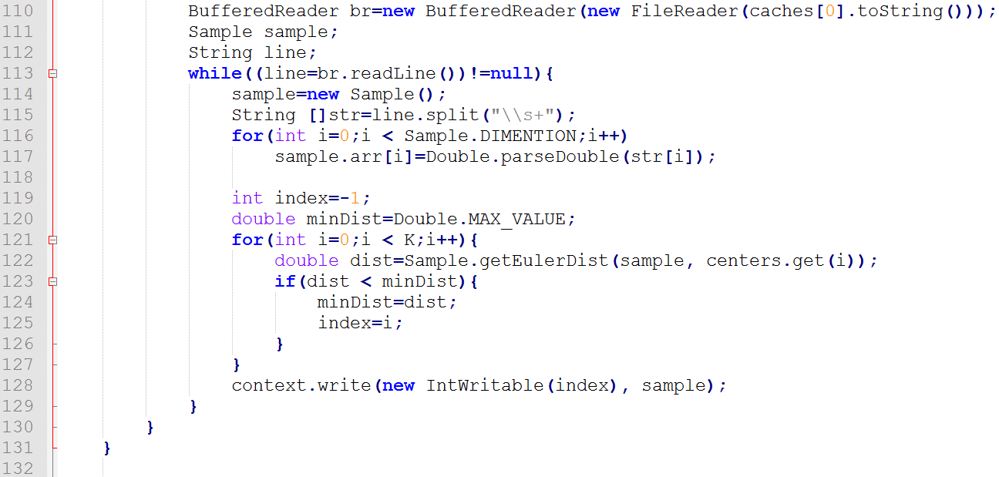
K-Means KMeans- ClusterMapper (8/12)
{1,(……)}
{6,(……)}
…
4
/user/root/input/synthetic_control.data
(...,…,…,…..
(…,…,…,…..
…..
2
3
Vector<Sample> centers
Sample.arr
Sample.arr
…..
1
sample.arr = {…,…,…,…..
sample.arr = {…,…,…,…..
sample.arr = {…,…,…,…..

Slide 11
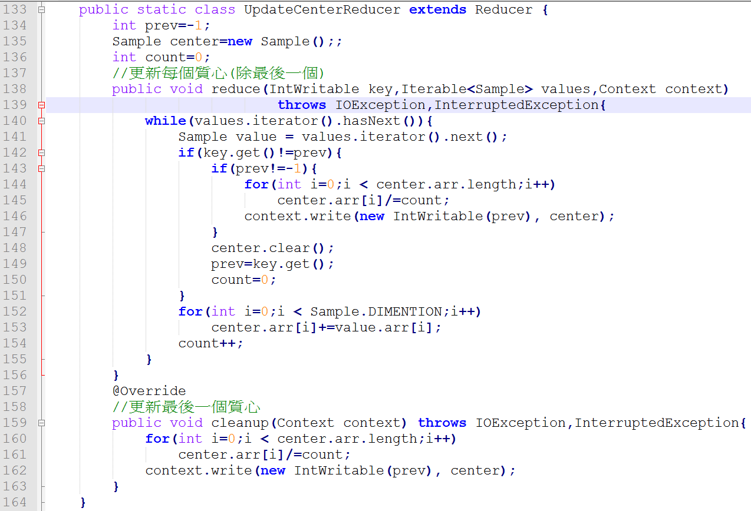
K-Means KMeans- UpdateCenterReducer (9/12)
3
center.arr[] = {(()+()+…)/n,(()+()+…)/n,…}
1
{key,value}
{x,(…,…,…)}
{x,(…,…,…)}
{x,(…,…,…)}
…
2
center.arr[] = {()+()+…,()+()+…,…}
count = n

Slide 12
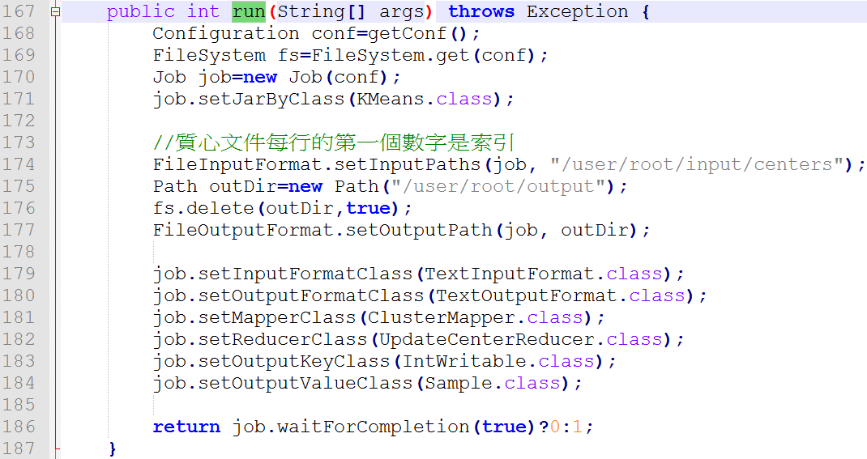
K-Means KMeans- run (10/12)

Slide 13
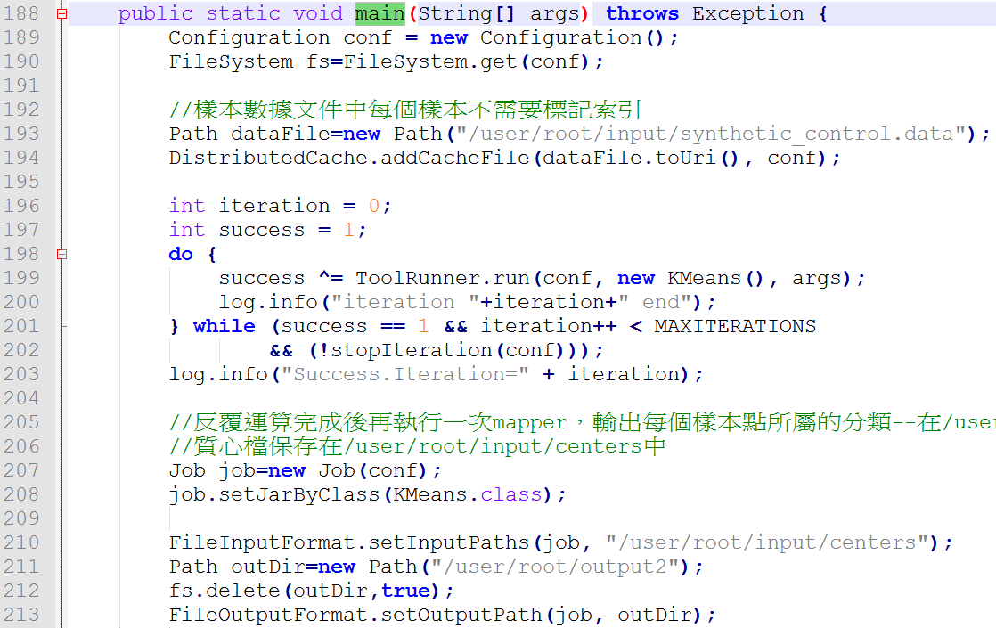
K-Means KMeans- main (11/12)

Slide 14
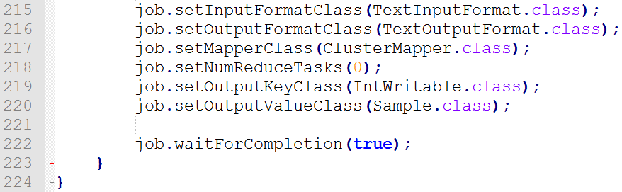
K-Means KMeans- main (12/12)

Slide 15
Mahout Installation and Configuration (1/5)
software | version
Operating system | Fedora 21
JDK | JDK 1.8.0_73
Hadoop | Hadoop 1.2.1
Mahout | Mahout 0.9
SSH | SSH 6.6

Slide 16
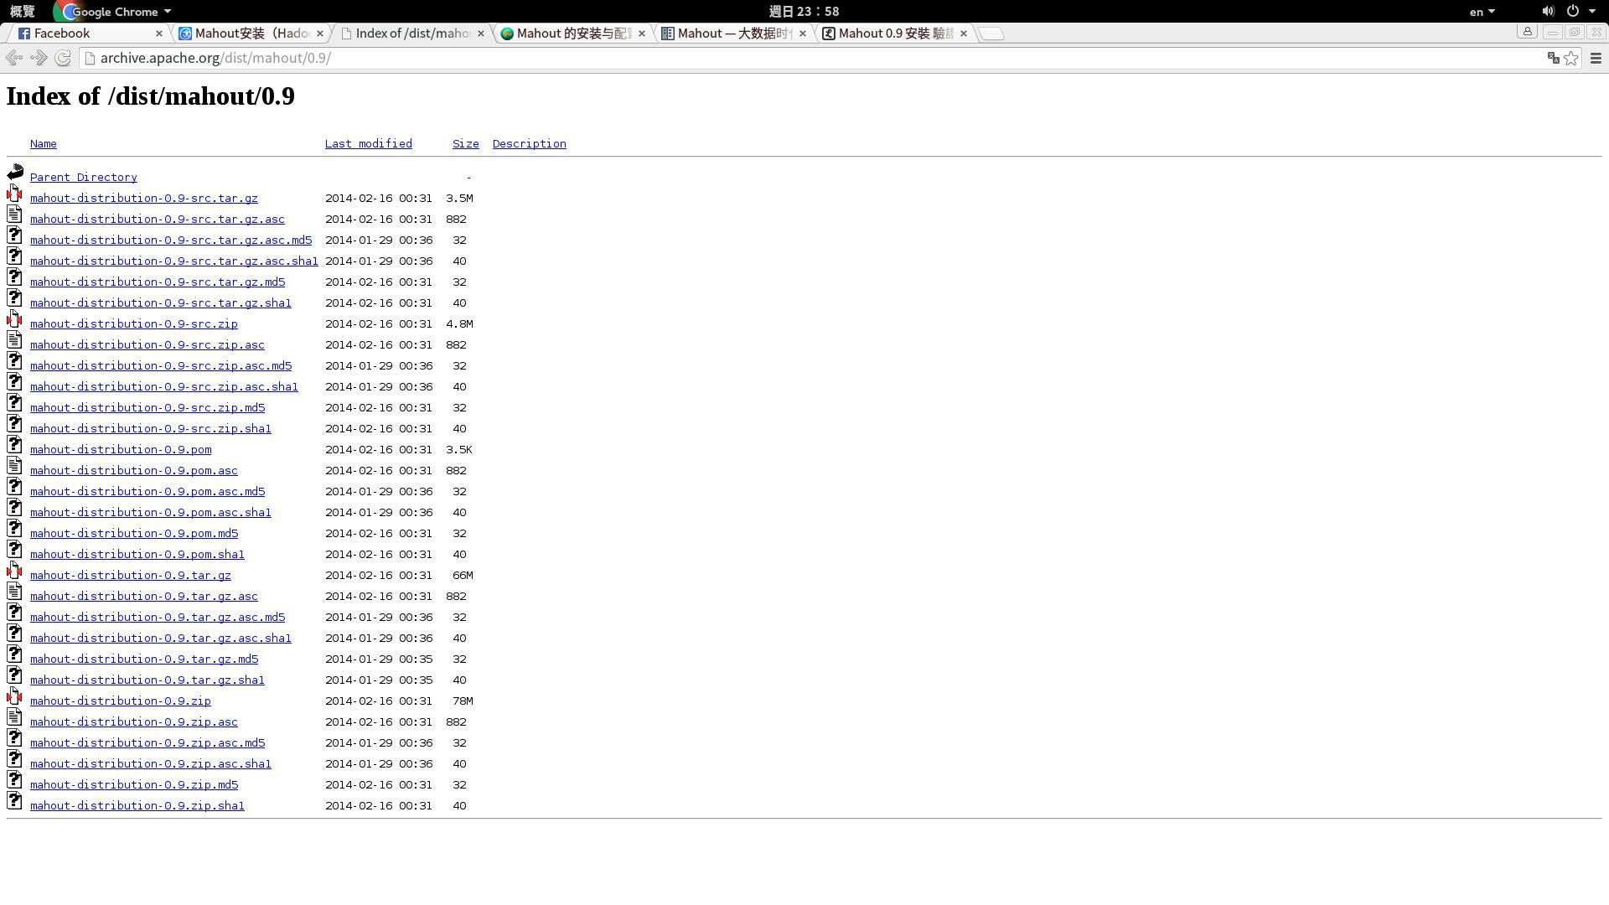
Mahout Installation and Configuration (2/5)
Download：http://archive.apache.org/dist/mahout/0.9/
mahout-distribution-0.9.tar.gz

Slide 17
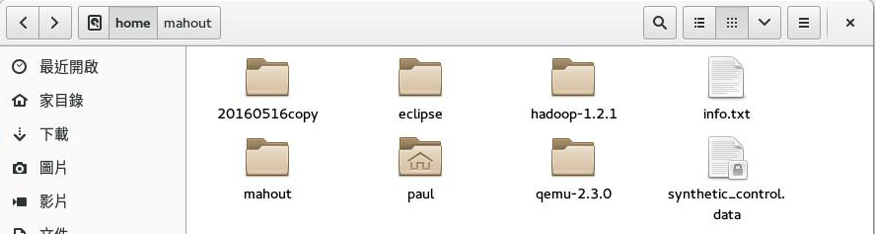
Mahout Installation and Configuration (3/5)
# tar -zxvf /home/mahout-distribution-0.9.tar.gz
# mv mahout-distribution-0.9/ ./mahout

Slide 18
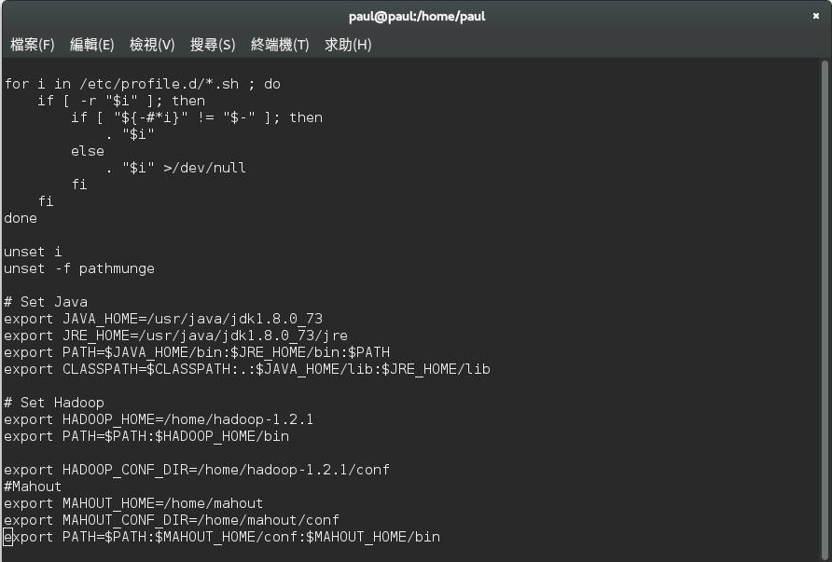
Mahout Installation and Configuration (4/5)
# vi /etc/profile
# source /etc/profile

Slide 19
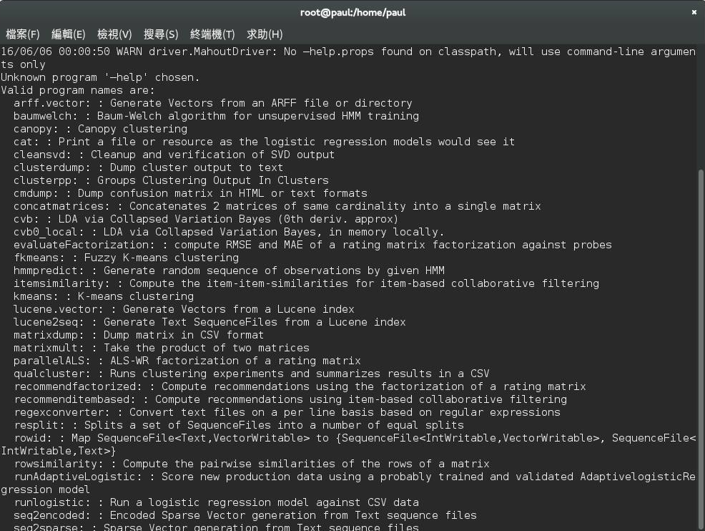
Mahout Installation and Configuration (5/5)
# /home/hadoop-1.2.1/bin/start-all.sh
# jps
# mahout –help

Slide 20
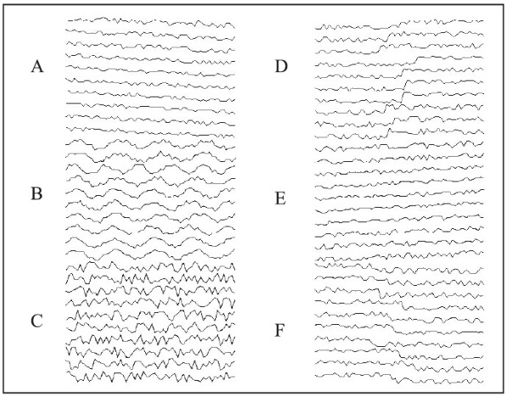
Test the installation (1/4)
# wget http://archive.ics.uci.edu/ml/databases/synthetic_control/synthetic_control.data
Notes:
測試資料是由Dr Robert Alcock在1999年利用程式合成的600個樣本的控制圖資料，每個樣本包括60個屬性列，一共可以分為6個類，分別為：正常（C）、迴圈（B）、上升趨勢（E）、下降趨勢（A）、向上移位（D）、向下移位（F）。圖中顯示的是每個類別的10個樣本資料圖。

Slide 21
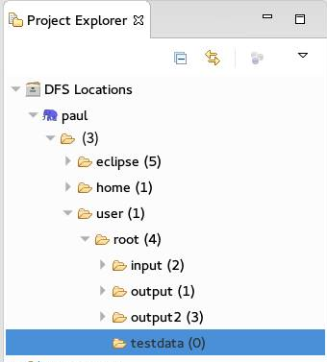
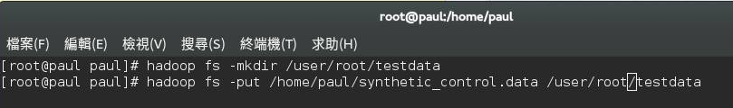
Test the installation (2/4)
# hadoop fs -mkdir /user/root/testdata
# hadoop fs -put /home/paul/synthetic_control.data /user/root/testdata

Slide 22
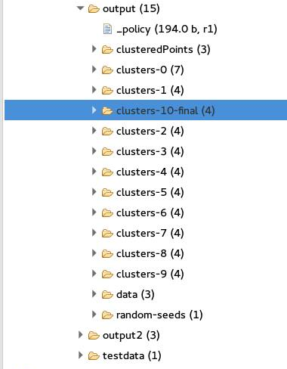
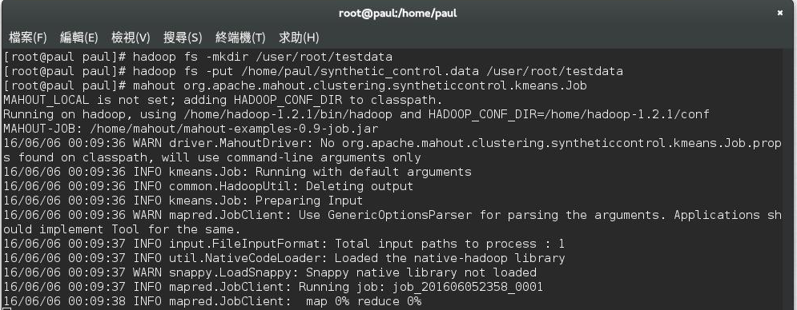
Test the installation (3/4)
# mahout org.apache.mahout.clustering.syntheticcontrol.kmeans.Job
# mahout seqdumper -i output/clusteredPoints -o clusteredPoints
# cat clusteredPoints

Slide 23
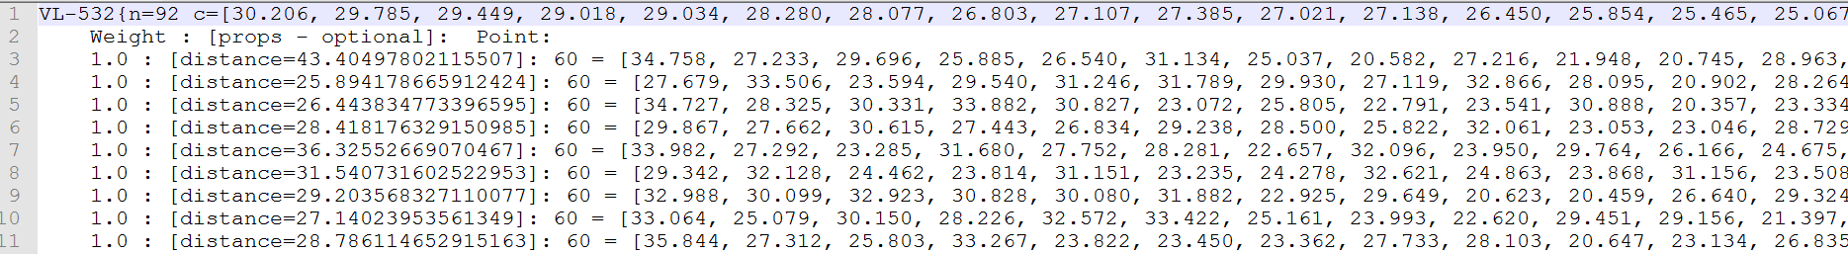
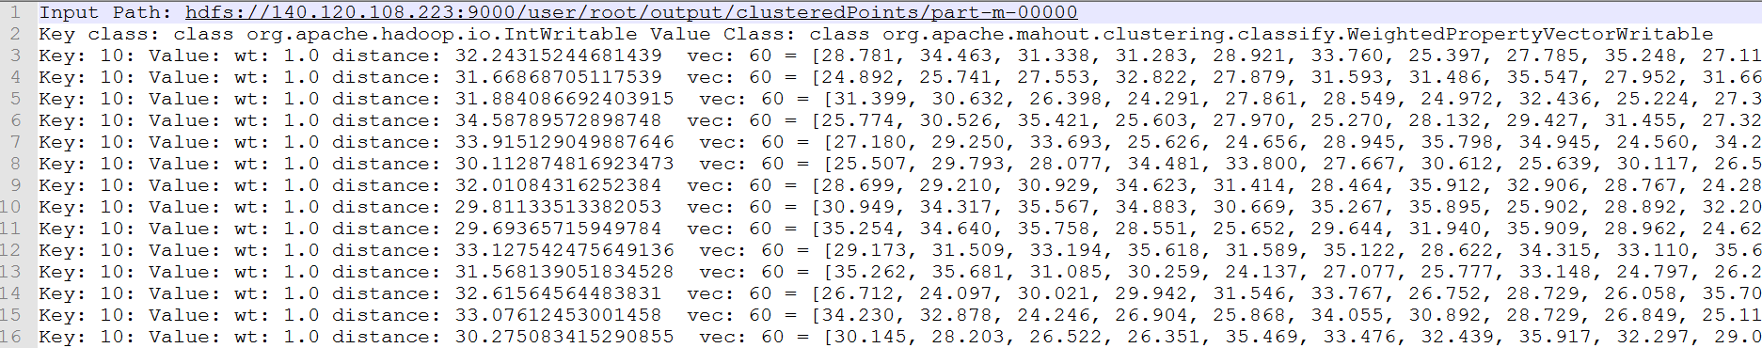
Test the installation (4/4)

